Slide 1


Data Structure
Course Code : ENCS205
Dr Swati Gupta
Associate Professor, School of Engineering & Technology
K.R. Mangalam University
Unit 4 :Trees and Graphs
Notes:
New Courses replaced with New Programmes

Slide 2

INTRODUCTION TO GRAPHS
Session 53
Traversal Techniques of Graph :BFS and DFS
Brainstorming Session
Notes:
New Courses replaced with New Programmes

Slide 3
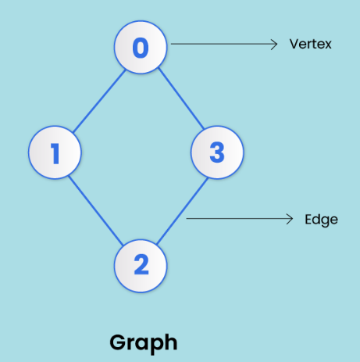
RECAP
A graph is a non-linear data structure made up of nodes or vertices and edges.
The edges connect any two nodes in the graph, and the nodes are also known as vertices.
Notes:
New Courses replaced with New Programmes

Slide 4
Graph Traversal
Graph traversal is a method used to search nodes in a graph.
There are two traversal Techniques :
Breadth First Search
Depth First Search
Notes:
New Courses replaced with New Programmes

Slide 5
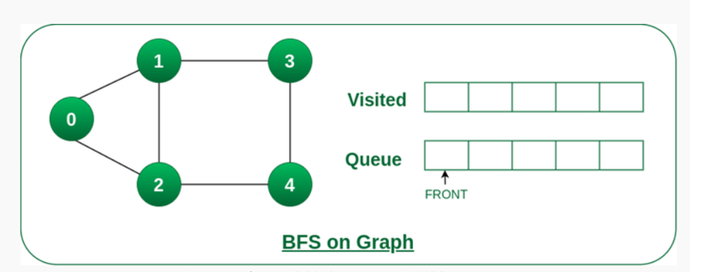
BFS (Breadth-First Search)
Breadth-First Search (BFS) is a graph traversal algorithm, where we start from a selected(source) node and traverse the graph level by level, by exploring the neighbor nodes at each level.
Notes:
New Courses replaced with New Programmes

Slide 6
Algorithm for BFS
Step 1 : Define a queue based on the number of nodes.
Step 2 : Start from any node, visit it, and add it to the queue.
Step 3 : Visit non-visited adjacent nodes in the queue.
Step 4 : Delete nodes without edges and not in the queue.
Step 5 : Empty the queue and form the spanning tree
Notes:
New Courses replaced with New Programmes

Slide 7
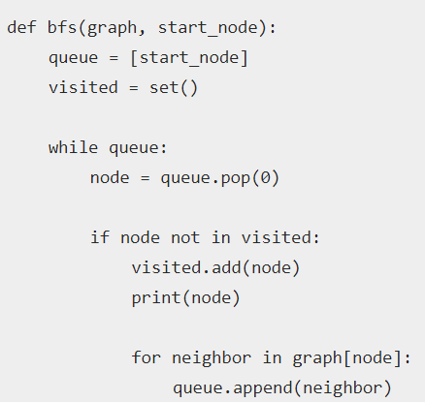
Algorithm for BFS: Pseudo code
Notes:
New Courses replaced with New Programmes

Slide 8
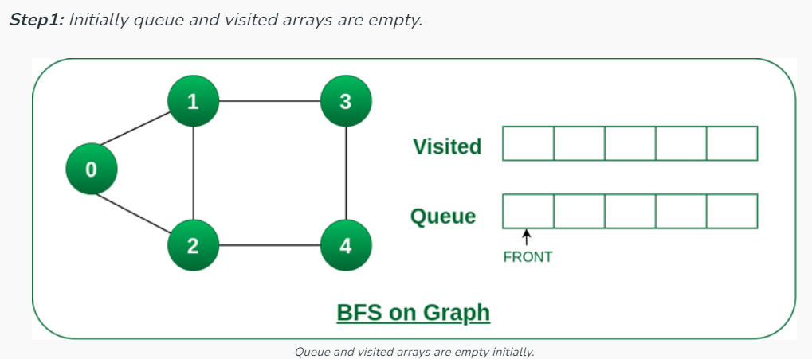
Example of BFS
Starting from the root, all the nodes at a particular level are visited first and then the nodes of the next level are traversed till all the nodes are visited.
Notes:
New Courses replaced with New Programmes

Slide 9
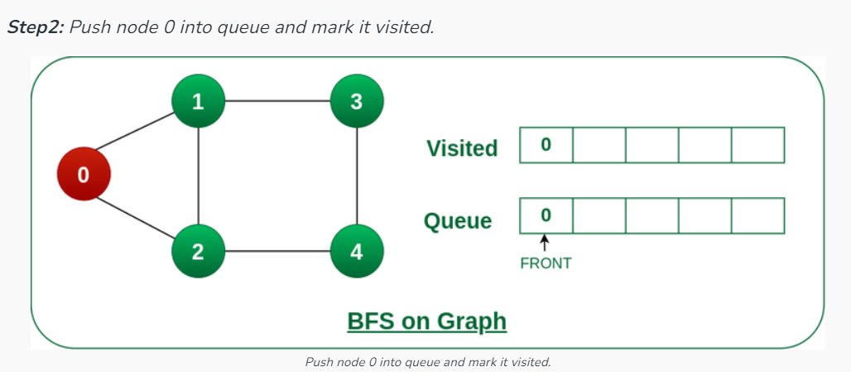
Example of BFS
Notes:
New Courses replaced with New Programmes

Slide 10
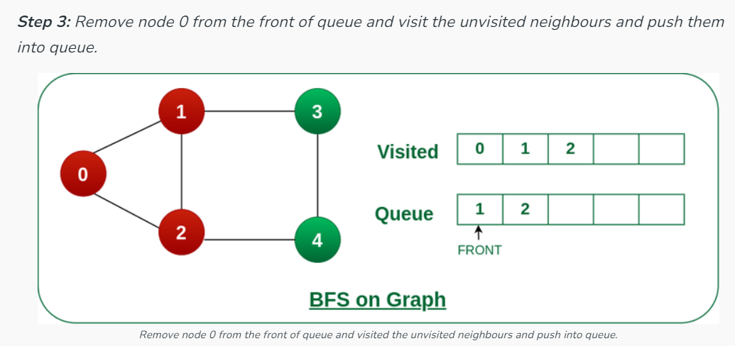
Example of BFS
Notes:
New Courses replaced with New Programmes

Slide 11
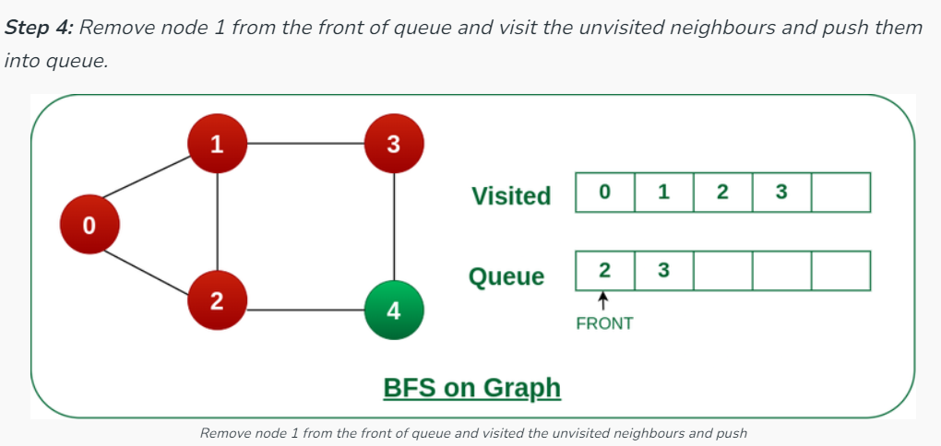
Example of BFS
Notes:
New Courses replaced with New Programmes

Slide 12
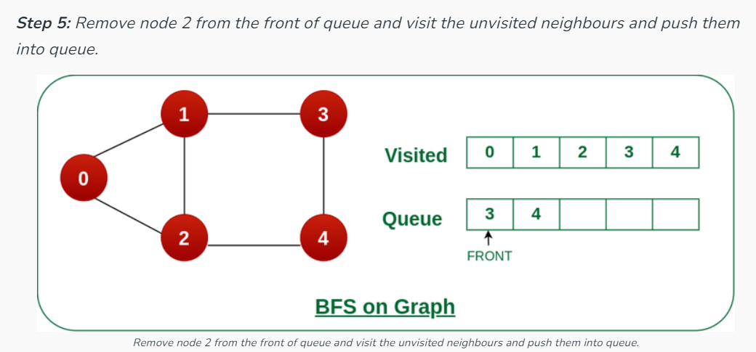
Example of BFS
Notes:
New Courses replaced with New Programmes

Slide 13
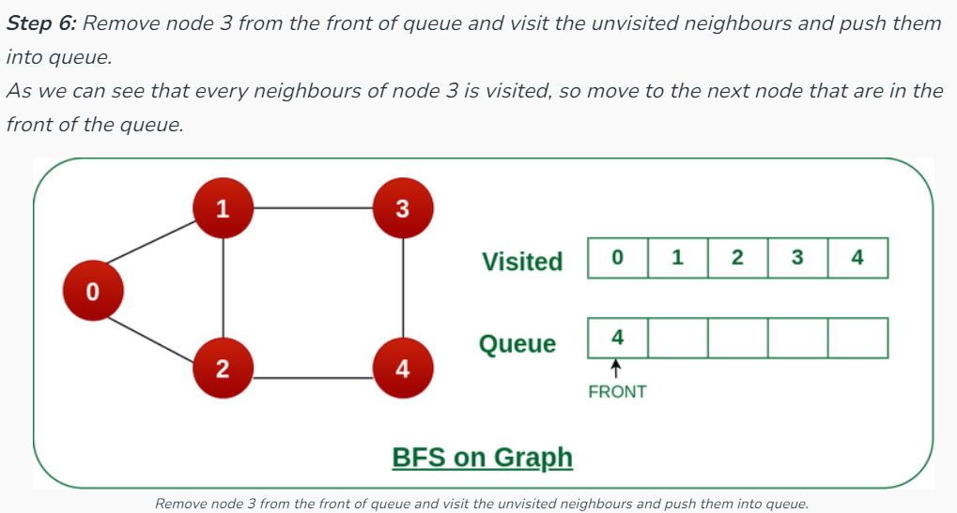
Example of BFS
Notes:
New Courses replaced with New Programmes

Slide 14
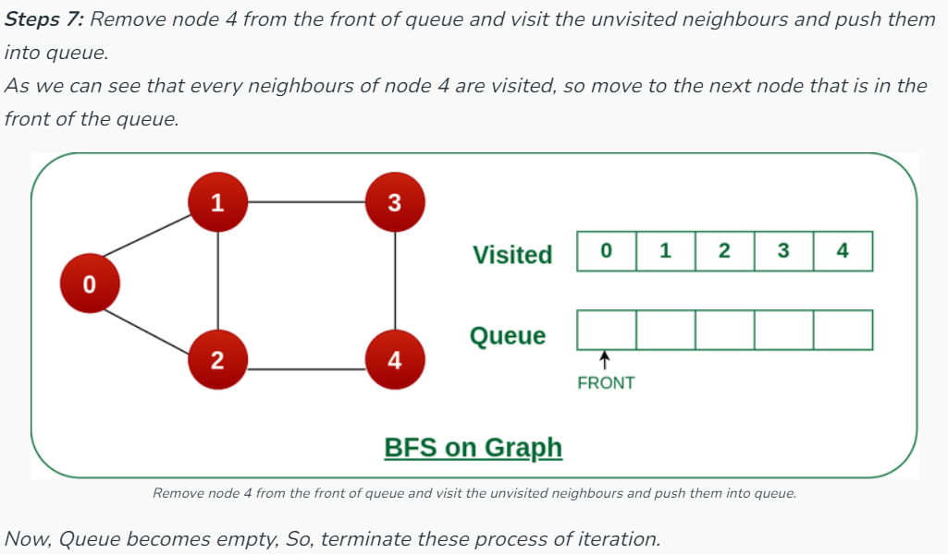
Example of BFS
Notes:
New Courses replaced with New Programmes

Slide 15

Implementing BFS traversal in Graph
BFS Traversal
void BFS(int startVertex) {
vector<bool> visited(numVertices, false);
queue<int> q;
visited[startVertex] = true;
q.push(startVertex);
cout << "BFS Traversal starting from vertex " << startVertex << ": ";

Slide 16
Implementing BFS traversal in Graph
BFS Traversal
while (!q.empty()) {
int vertex = q.front();
q.pop();
cout << vertex << " ";
for (int adjVertex : adjList[vertex]) {
if (!visited[adjVertex]) {
visited[adjVertex] = true;
q.push(adjVertex);
}
}
}
cout << endl;
}
Access the Complete Code here :https://onlinegdb.com/m5if5mL4_

Slide 17
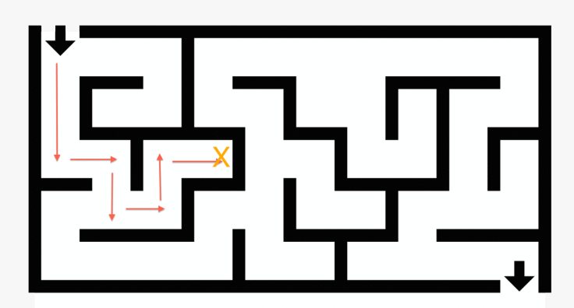
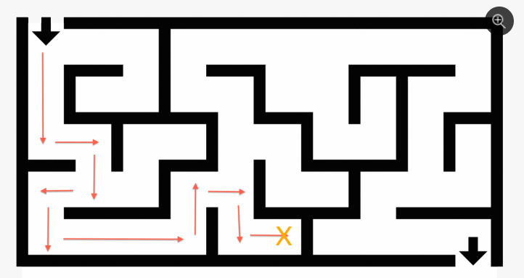
What Approach do you follow in solving a MAZE ?
DEPTH FIRST SEARCH
Notes:
New Courses replaced with New Programmes

Slide 18
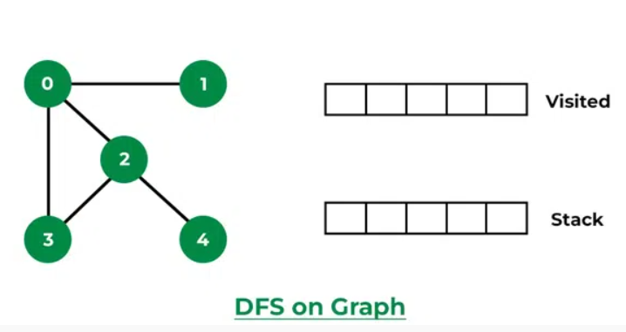
DFS (Depth-First Search)
Depth-First Search (DFS) is a graph traversal algorithm, which starts at the root node and examines each branch as far as possible before backtracking.
Notes:
New Courses replaced with New Programmes

Slide 19
Algorithm for DFS
Step 1: SET STATUS = 1 (ready state) for each node in G
Step 2: Push the starting node A on the stack and set its STATUS = 2 (waiting state)
Step 3: Repeat Steps 4 and 5 until STACK is empty
Step 4: Pop the top node N. Process it and set its STATUS = 3 (processed state)
Notes:
New Courses replaced with New Programmes

Slide 20
Algorithm for DFS
Step 5: Push on the stack all the neighbors of N that are in the ready state (whose STATUS = 1) and set their STATUS = 2 (waiting state)
[END OF LOOP]
Notes:
New Courses replaced with New Programmes

Slide 21
Algorithm for DFS: Pseudo code
DFS(G,v) ( v is the vertex where the search starts )
Stack S := {}; ( start with an empty stack )
for each vertex u, set visited[u] := false;
push S, v;
while (S is not empty) do
u := pop S;
if (not visited[u]) then
visited[u] := true;
for each unvisited neighbour w of u
push S, w;
end if
end while
END DFS()
Notes:
New Courses replaced with New Programmes

Slide 22
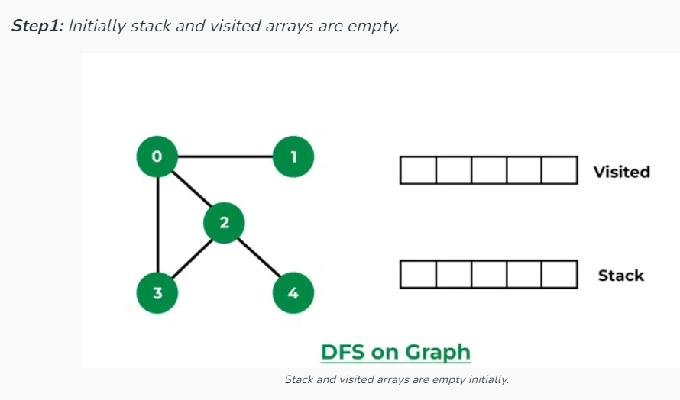
Example of DFS
Notes:
New Courses replaced with New Programmes

Slide 23
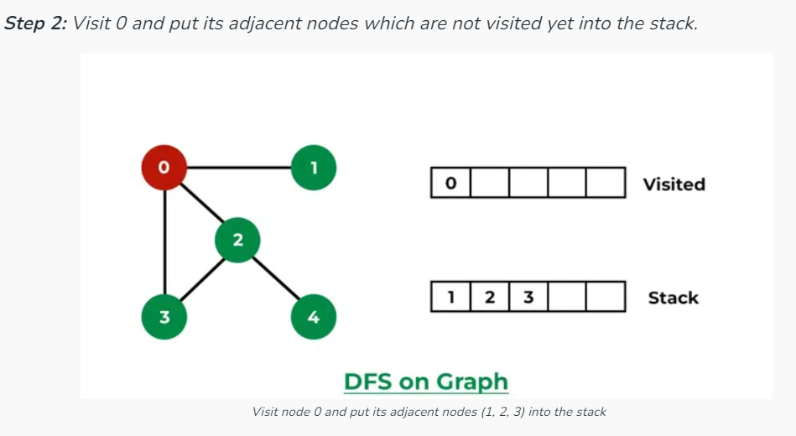
Example of DFS
Notes:
New Courses replaced with New Programmes

Slide 24
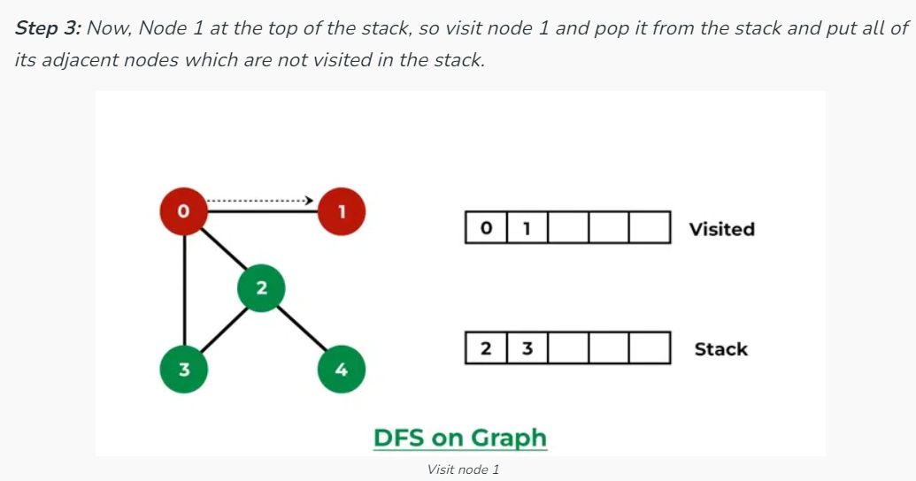
Example of DFS
Notes:
New Courses replaced with New Programmes

Slide 25
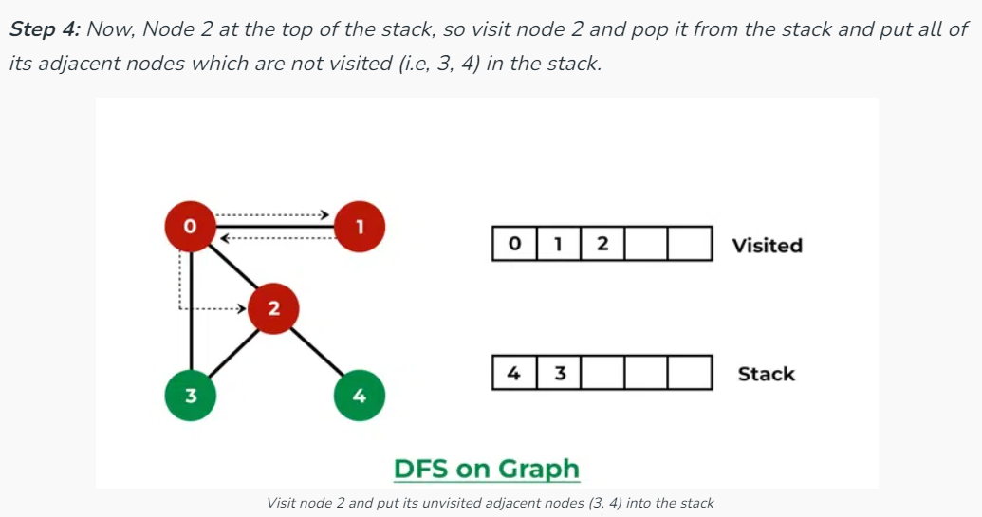
Example of DFS
Notes:
New Courses replaced with New Programmes

Slide 26
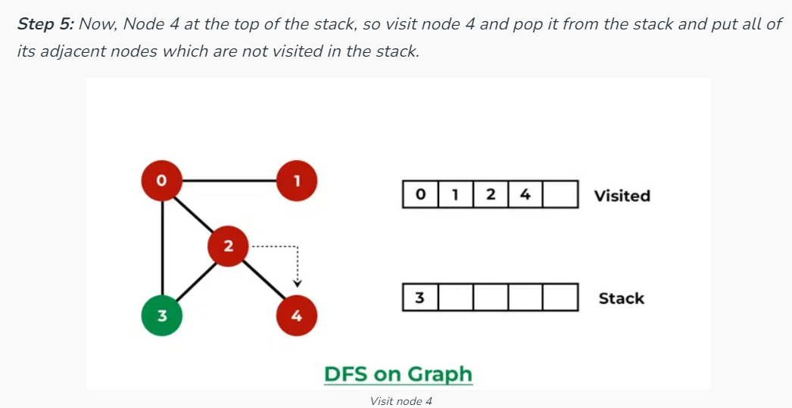
Example of DFS
Notes:
New Courses replaced with New Programmes

Slide 27
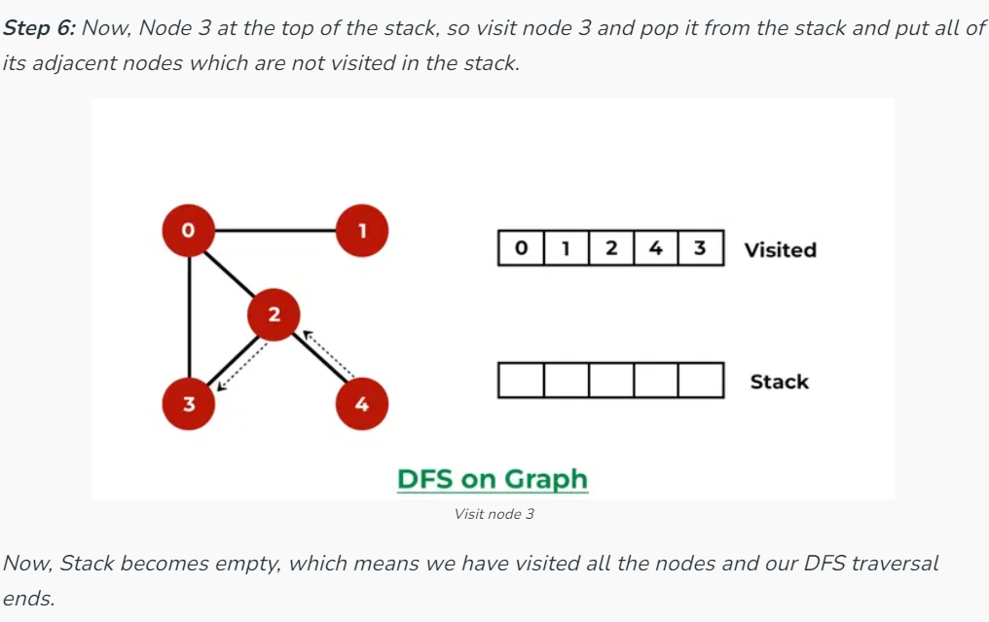
Example of DFS
Notes:
New Courses replaced with New Programmes

Slide 28
Implementing DFS traversal in Graph
DFS Traversal
void DFSUtil(int vertex, vector<bool>& visited) {
visited[vertex] = true;
cout << vertex << " ";
for (int adjVertex : adjList[vertex]) {
if (!visited[adjVertex]) {
DFSUtil(adjVertex, visited);
}
}
}
Access the Complete Code here :https://onlinegdb.com/m5if5mL4_

Slide 29
Implementing DFS traversal in Graph
DFS Traversal
void DFS(int startVertex) {
vector<bool> visited(numVertices, false);
cout << "DFS Traversal starting from vertex " << startVertex << ": ";
DFSUtil(startVertex, visited);
cout << endl;
}
};
Access the Complete Code here :https://onlinegdb.com/m5if5mL4_

Slide 30
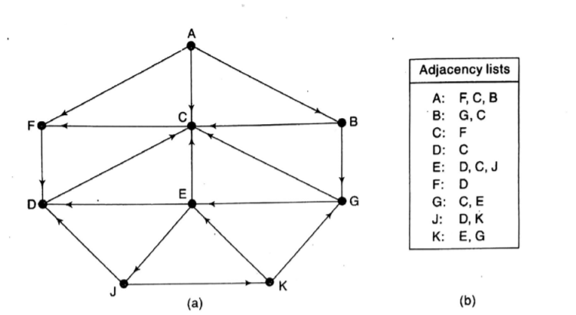
Q1 Consider a Graph G and Perform the graph traversal using BFS and DFS
Exercise Question
Notes:
New Courses replaced with New Programmes

Slide 31
REVIEW
Graph traversal is a method used to search nodes in a graph.
There are two traversal Techniques :
Breadth First Search
Depth First Search
Notes:
New Courses replaced with New Programmes

Slide 32
Test Your Knowledge
Q1 A person wants to visit some places. He starts from a vertex and then wants to visit every place connected to this vertex and so on. What algorithm he should use? a) Depth First Search b) Breadth First Search c) Trim’s algorithm d) Kruskal’s algorithm
Answer (B)
Q2 Which of the following is not an application of Breadth First Search? a) Finding shortest path between two nodes b) Finding bipartiteness of a graph c) GPS navigation system d) Path Finding
Answer (D)
Notes:
New Courses replaced with New Programmes

Slide 33
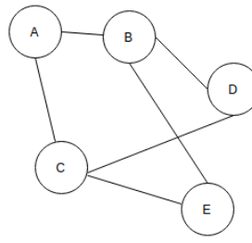
Test Your Knowledge
Q3 In BFS, how many times a node is visited? a) Once b) Twice c) Equivalent to number of indegree of the node d) Thrice
Answer (C)
Q4 For the given graph(G), which of the following statements is true?
a) G is a complete graph b) G is not a connected graph c) The vertex connectivity of the graph is 2 d) The edge connectivity of the graph is 1
Answer (C)
Notes:
New Courses replaced with New Programmes

Slide 34
Test Your Knowledge
Q5 Which of the following is true? a) A graph may contain no edges and many vertices b) A graph may contain many edges and no vertices c) A graph may contain no edges and no vertices d) A graph may contain no vertices and many edges
Answer (B)
Q6 If a Graph Structured Stack contains {1,2,3,4} {1,5,3,4} {1,6,7,4} and {8,9,7,4}, what would be the source and sink vertices of the DAC? a) Source – 1, 8 Sink – 7,4 b) Source – 1 Sink – 8,4 c) Source – 1, 8 Sink – 4 d) Source – 4, Sink – 1,8
Answer (C)
Notes:
New Courses replaced with New Programmes

Slide 35
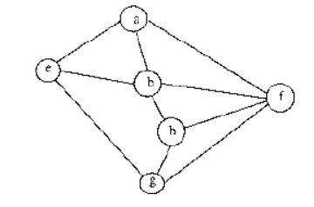
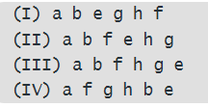
Test Your Knowledge
Q7 Consider the following graph, Among the following sequences:Which are depth first traversals of the above graph?
I,II and IV only
I and III only
I,III and IV only
I and IV only
Answer (B)
Answer (C)
Notes:
New Courses replaced with New Programmes

Slide 36
References
https://www.boardinfinity.com/blog/graphs-in-data-structure/.
https://www.geeksforgeeks.org/what-is-graph-data-structure/
https://www.tutorialspoint.com/data_structures_algorithms/graph_data_structure.html.
https://www.simplilearn.com/tutorials/data-structure-tutorial/graphs-in-data-structure
https://www.geeksforgeeks.org/applications-of-graph-data-structure/
https://www.upgrad.com/blog/graphs-in-data-structure/
https://www.youtube.com/watch?v=4IZ80K72OXo
Notes:
New Courses replaced with New Programmes

Slide 37
THANK YOU

